Slide 1
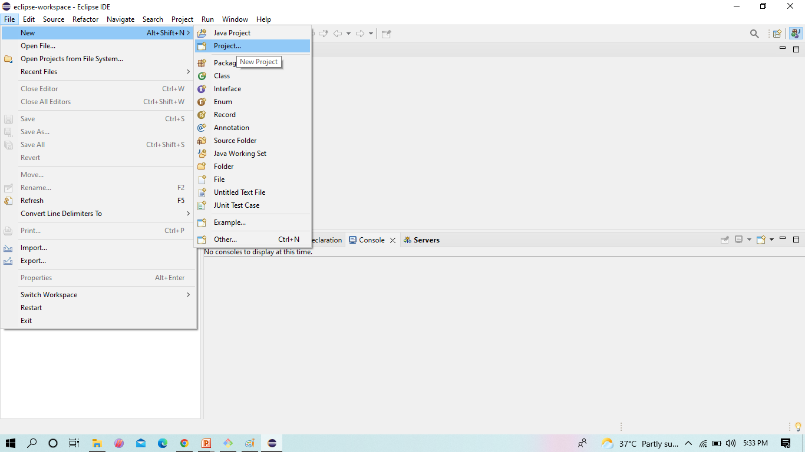
Maven Web Project in Eclipse
Go to- > File - > New -> Maven Project

Slide 2
Maven Web Project steps
1. Go to- > File - > New -> Maven Project->Next
2. Select the org.apache.maven.archetypes with maven-archetype-webapp and click Next
3. Provide the Group id , Artifact id(file name) and click Finish, Maven web Project is created
4. Here the project created , Check for index .jsp file containing Hello Welcome to maven web
5. In pom.xml add the dependencies as shown below.
6. To run the project right click and Run as Maven Clean - It clears out the existing classes previous one . Here we can see the console for Build Success.
7. Now again run the project right click and Run as Maven Install – to add artifacts to the project
8. Again run the project Maven test – to test the project
9. Now run the project Run as Maven Build – it creates JAR/WAR files to the project
10. Here specify the goals -> they clean install test or Package ,click -> Apply & Run
11. Now run the project as Run on server
12. Here we have to select the tomcat server 9.0 ,Click -> Finish
13 we can see output in browser

Slide 3
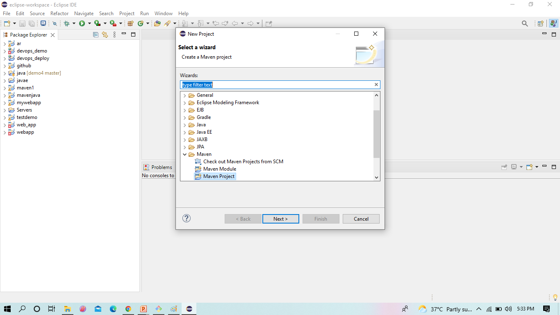
Select the Maven Project
Maven Web Project in Eclipse

Slide 4
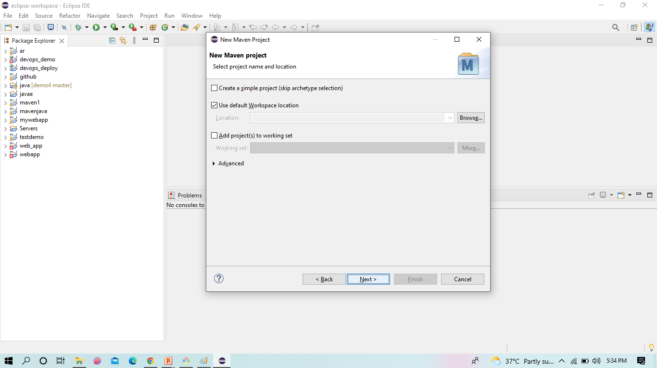
Click -> Next
Maven Web Project in Eclipse

Slide 5
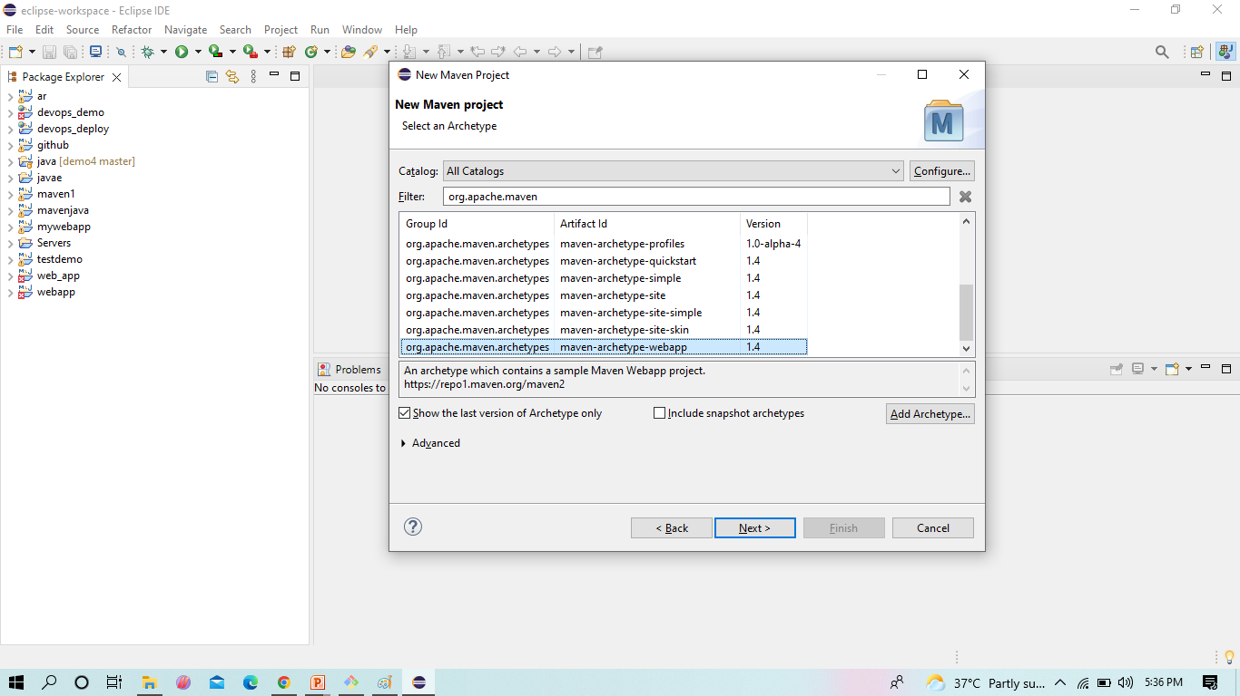
Select the org.apache.maven.archetypes with maven-archetype-webapp and click Next
Maven Web Project in Eclipse

Slide 6
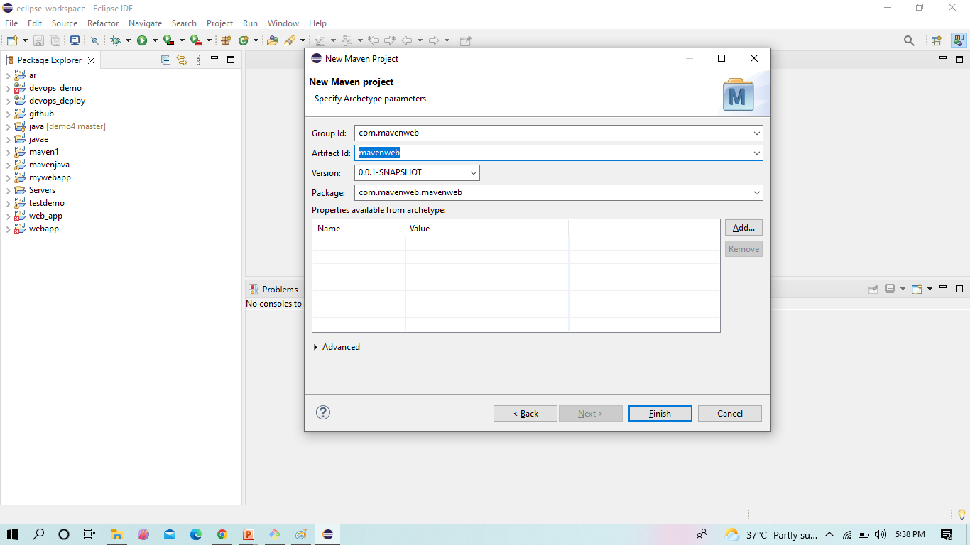
Provide the Group id , Artifact id(file name) and click Finish, Maven web Project is created
Maven Web Project in Eclipse

Slide 7
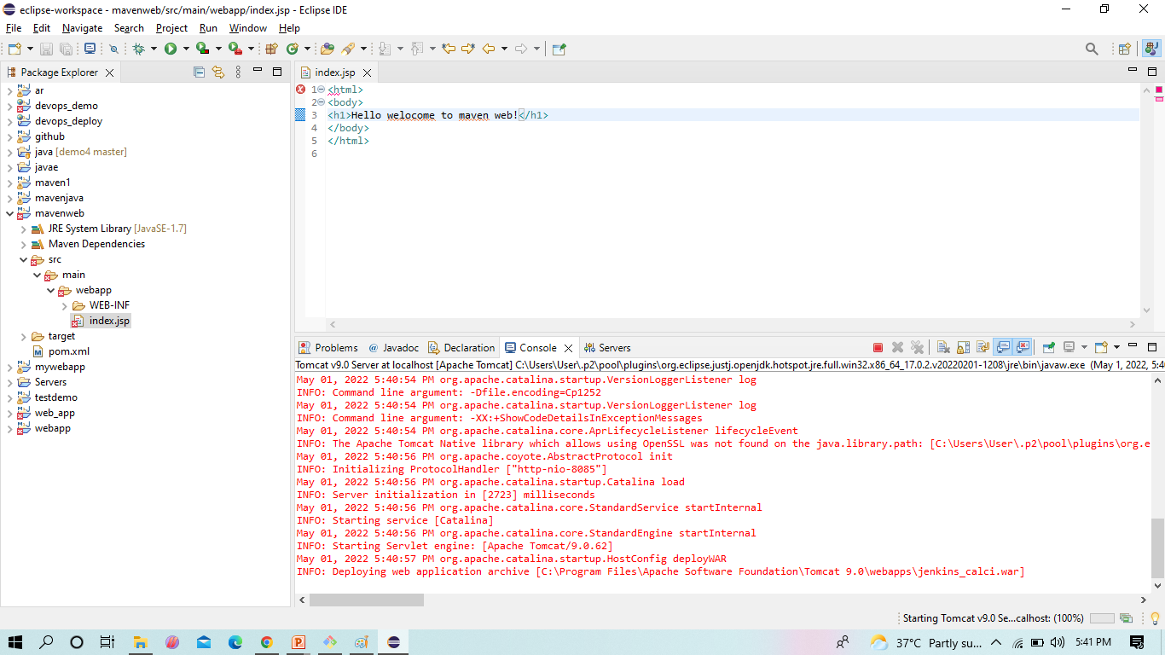
Here the project created , Check for index .jsp file containing Hello Welcome to maven web
In index.jsp file type text as
“Hello from ‘your name e.g. Yogita ‘ web project”

Slide 8
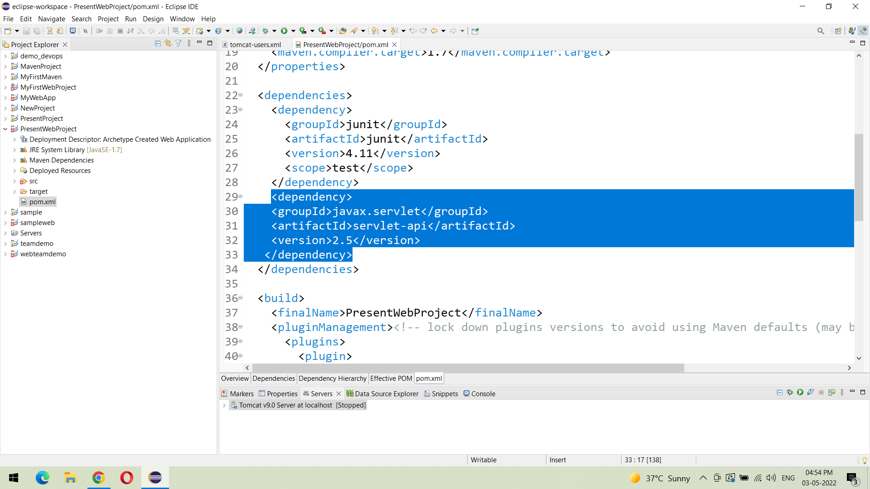
In pom.xml add the dependencies as shown below.
Maven Web Project in Eclipse

Slide 9
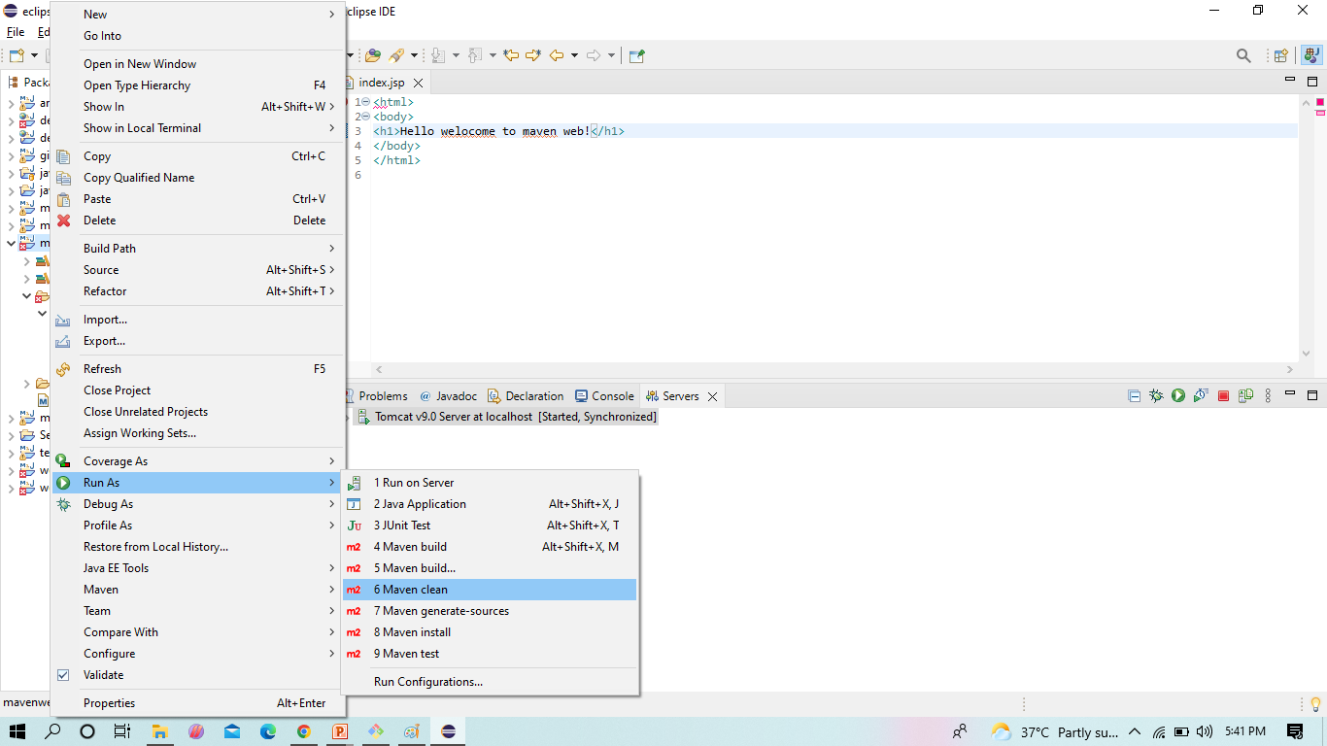
To run the project right click and Run as Maven Clean - It clears out the existing classes previous one
Maven Web Project in Eclipse

Slide 10
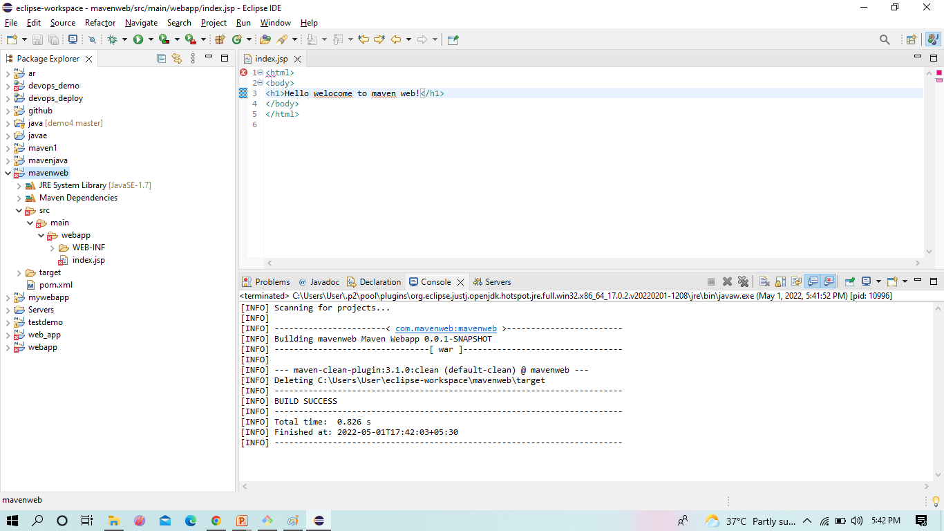
Here we can see the console for Build Success.
Maven Web Project in Eclipse

Slide 11
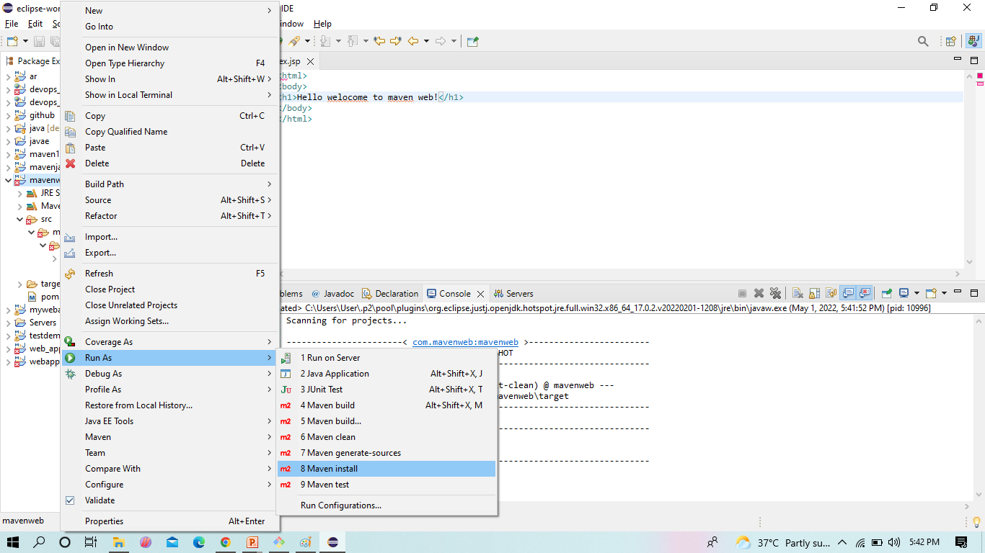
Now again run the project right click and Run as Maven Install – to add artifacts to the project
Maven Web Project in Eclipse

Slide 12
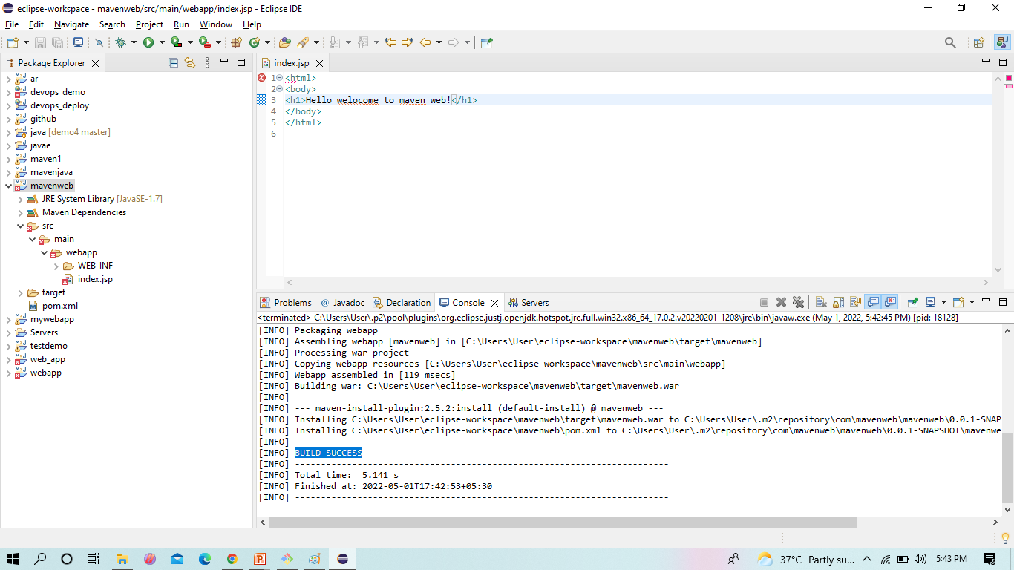
Here we can see the console for Build Success
Maven Web Project in Eclipse

Slide 13
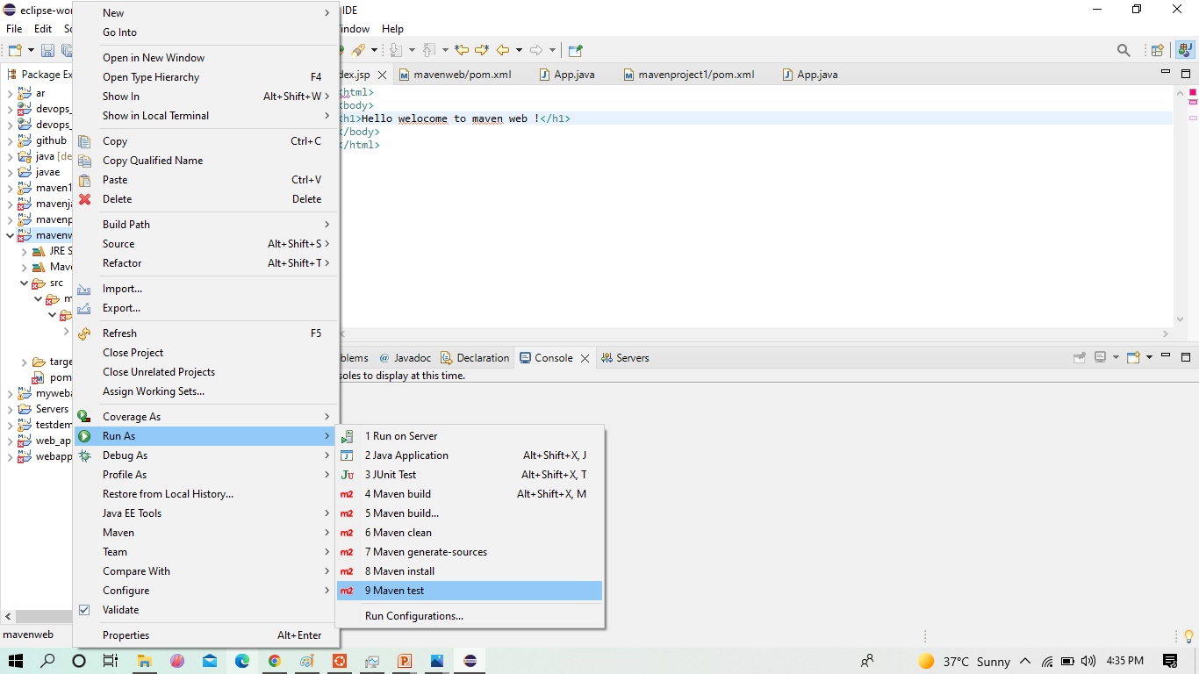
Again run the project Maven test – to test the project
Maven Web Project in Eclipse

Slide 14
Here we can see the console for Build Success
Maven Web Project in Eclipse

Slide 15
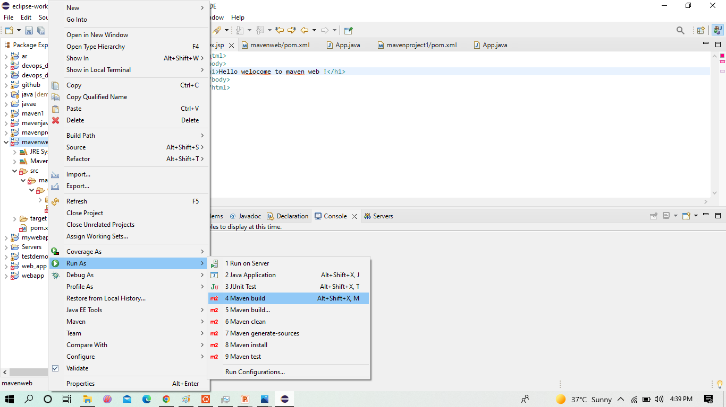
Now run the project Run as Maven Build – it creates JAR/WAR files to the project
Maven Web Project in Eclipse

Slide 16
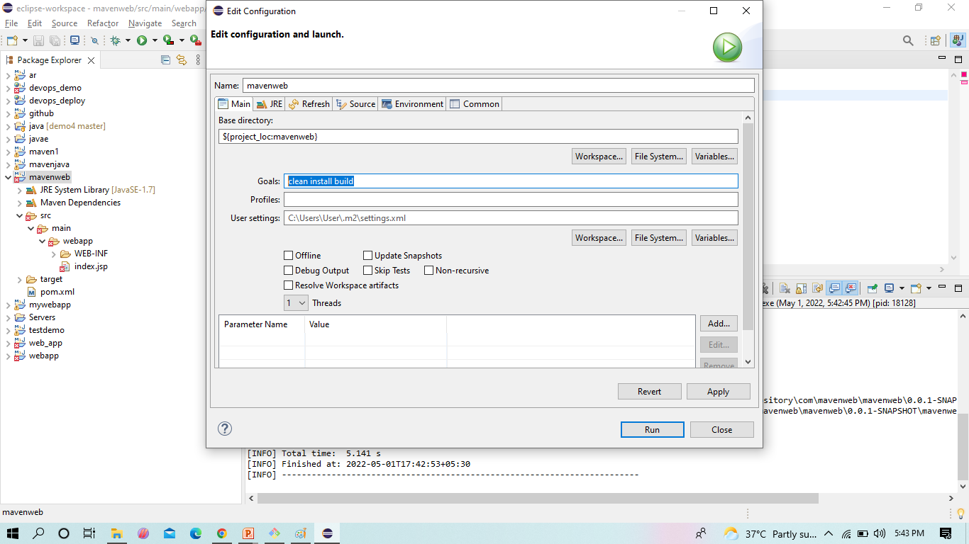
Here specify the goals -> they clean install test or Package ,click -> Apply & Run
Maven Web Project in Eclipse

Slide 17
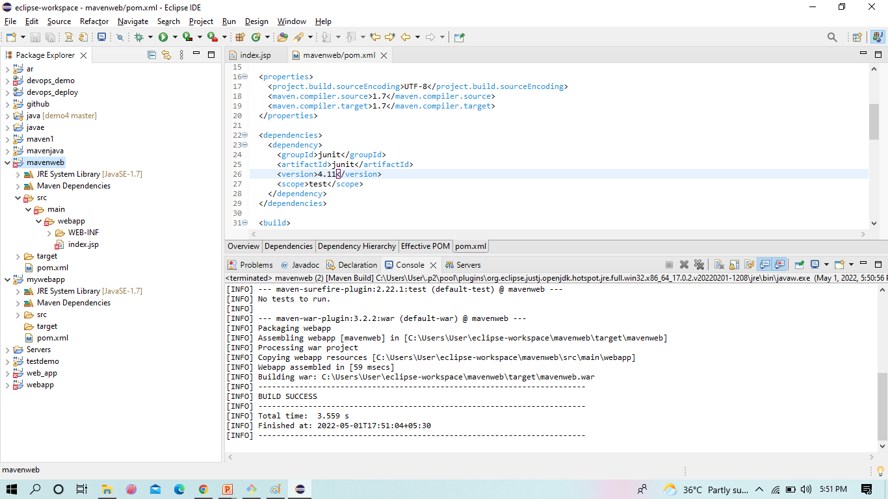
We see the console output
Maven Web Project in Eclipse

Slide 18
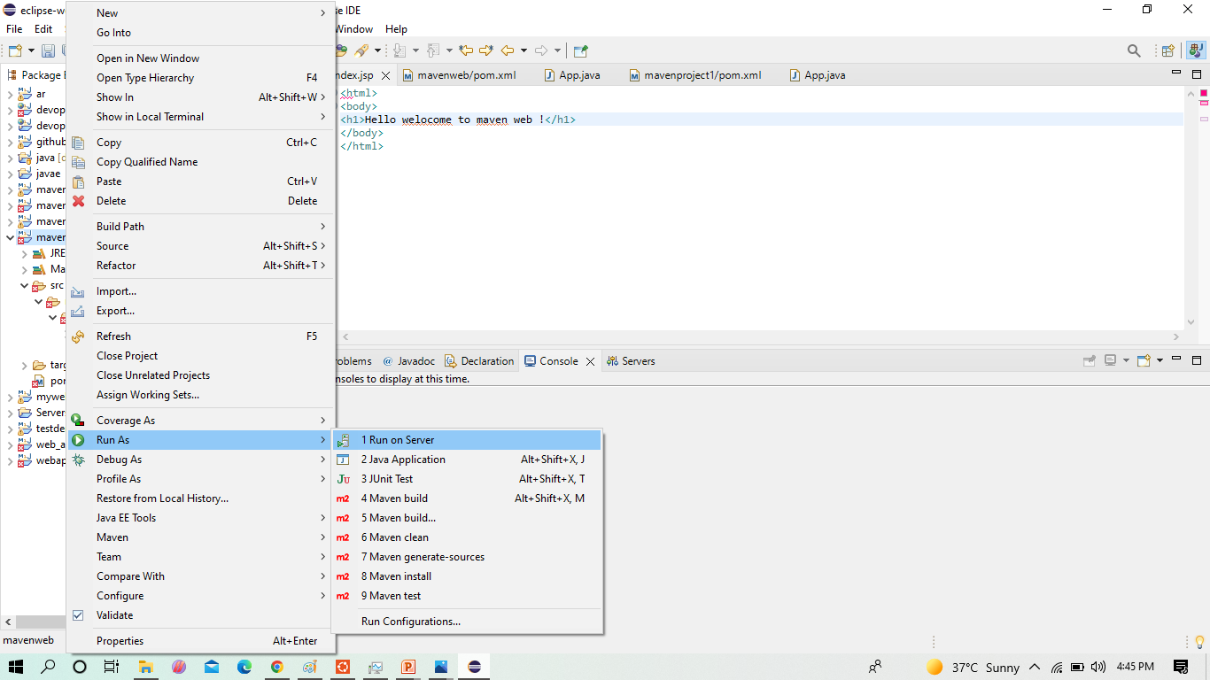
Now run the project as Run on server
Maven Web Project in Eclipse

Slide 19
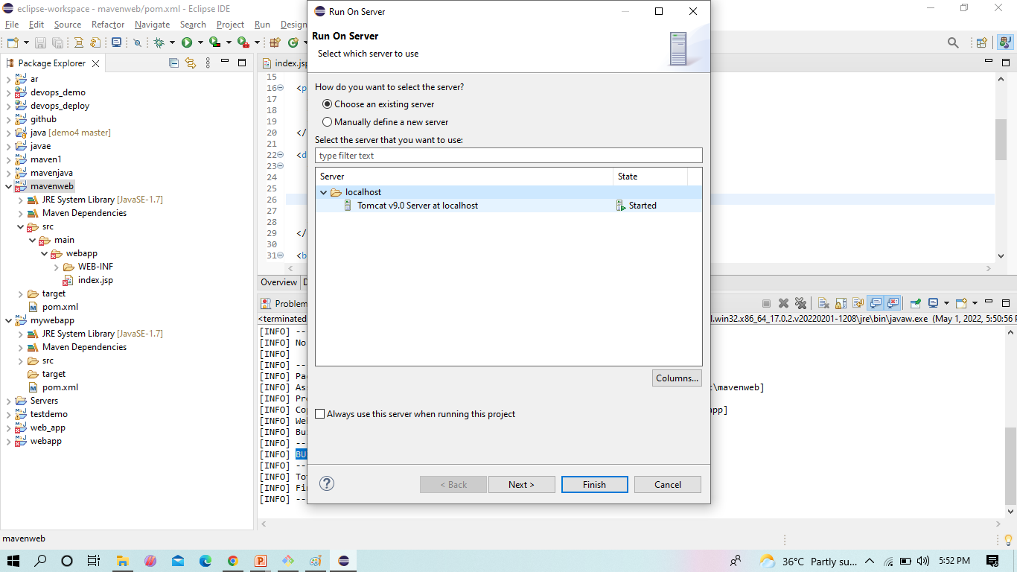
Here we have to select the tomcat server 9.0 ,Click -> Finish
Maven Web Project in Eclipse

Slide 20
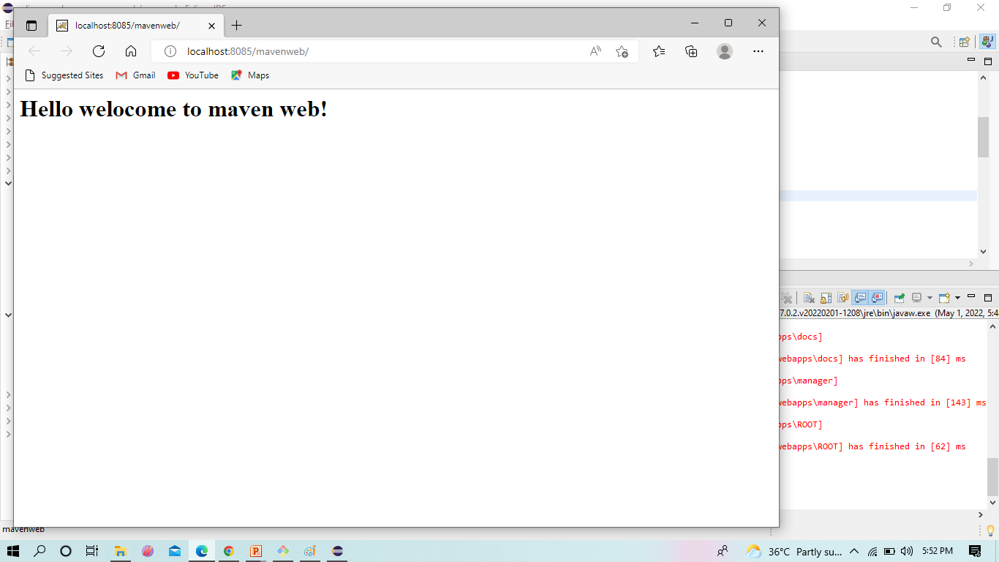
Here we can see output here
Maven Web Project in Eclipse

Slide 21
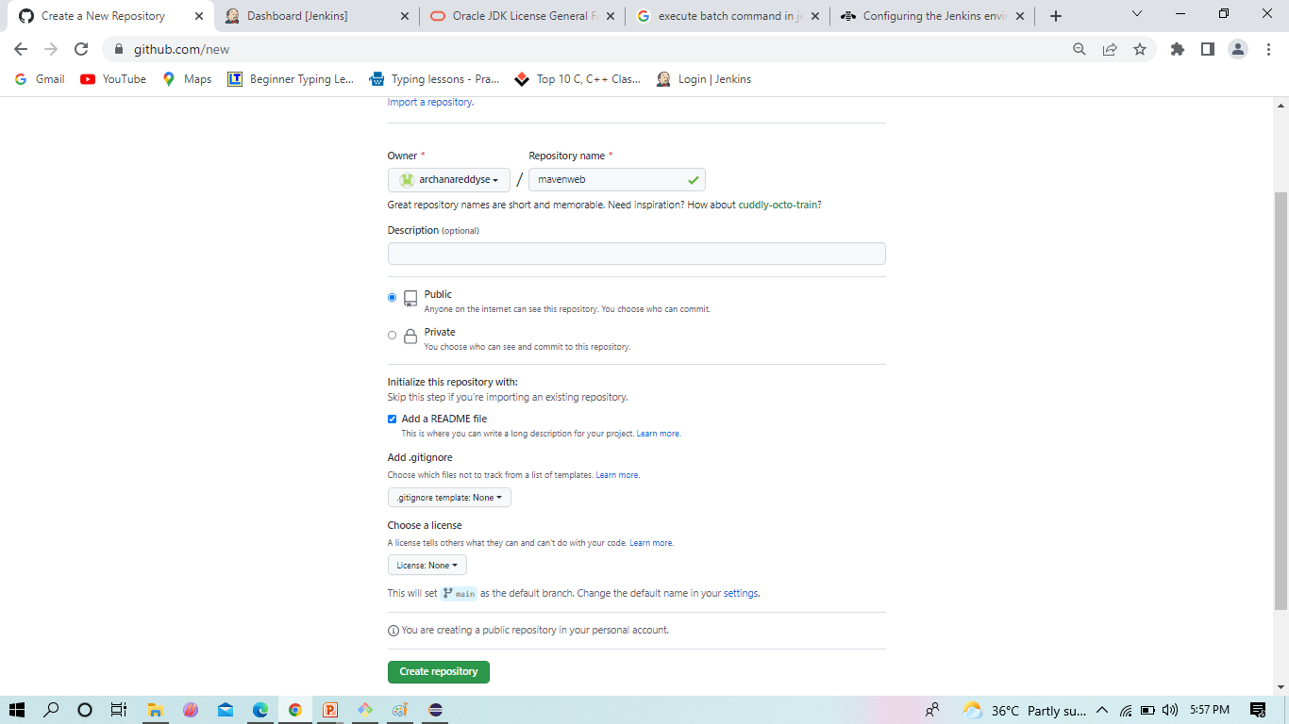
Now come Git hub ,here create a empty repository to get the maven web project
Maven Project in Eclipse

Slide 22
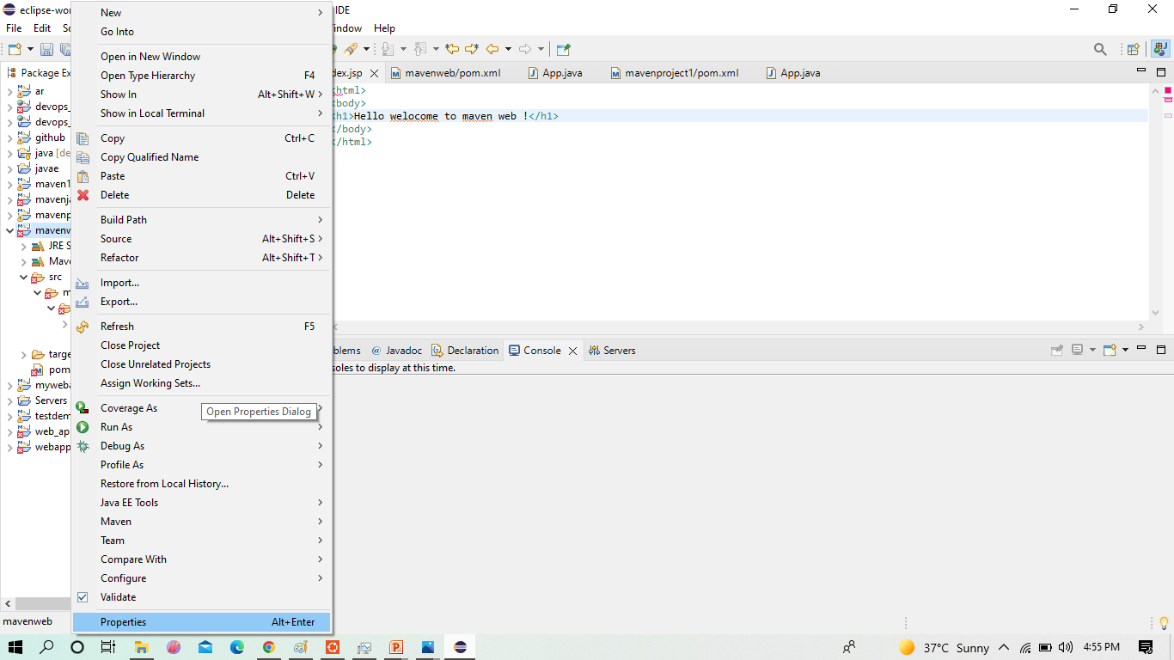
To get the path Right click ,and select the properties
Maven Web Project in Eclipse

Slide 23
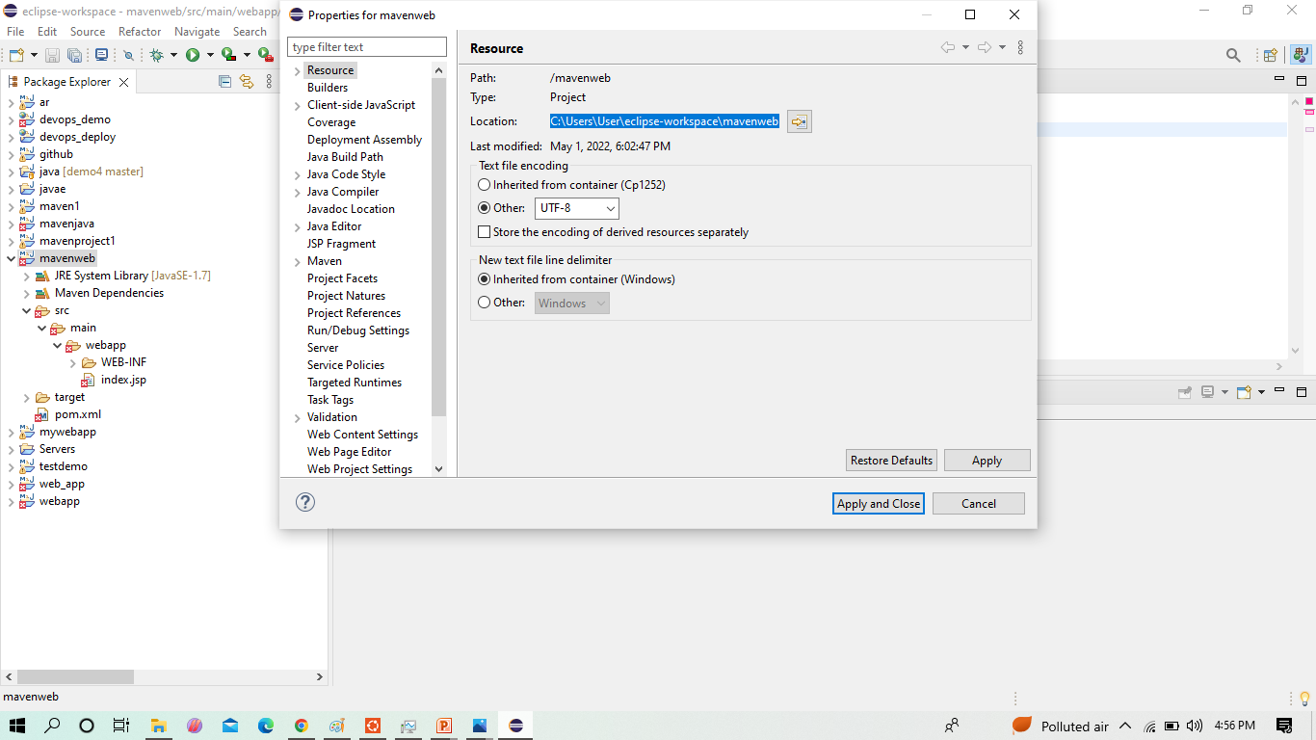
From here we copy the path of eclipse workspace.
Maven Web Project in Eclipse

Slide 24
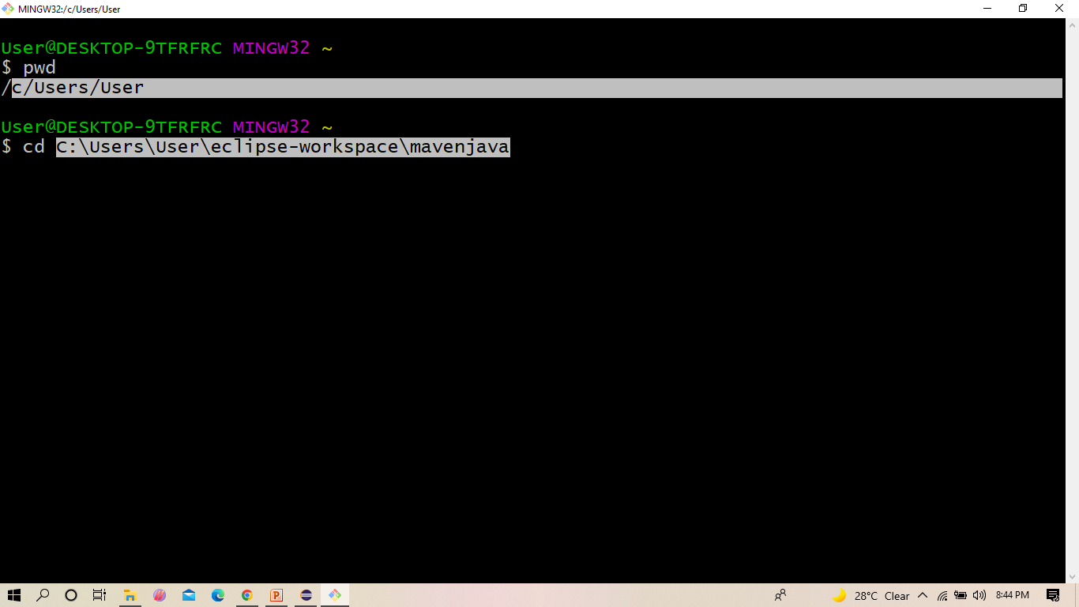
Change the directory to eclipse workspace
Maven Web Project in Eclipse

Slide 25
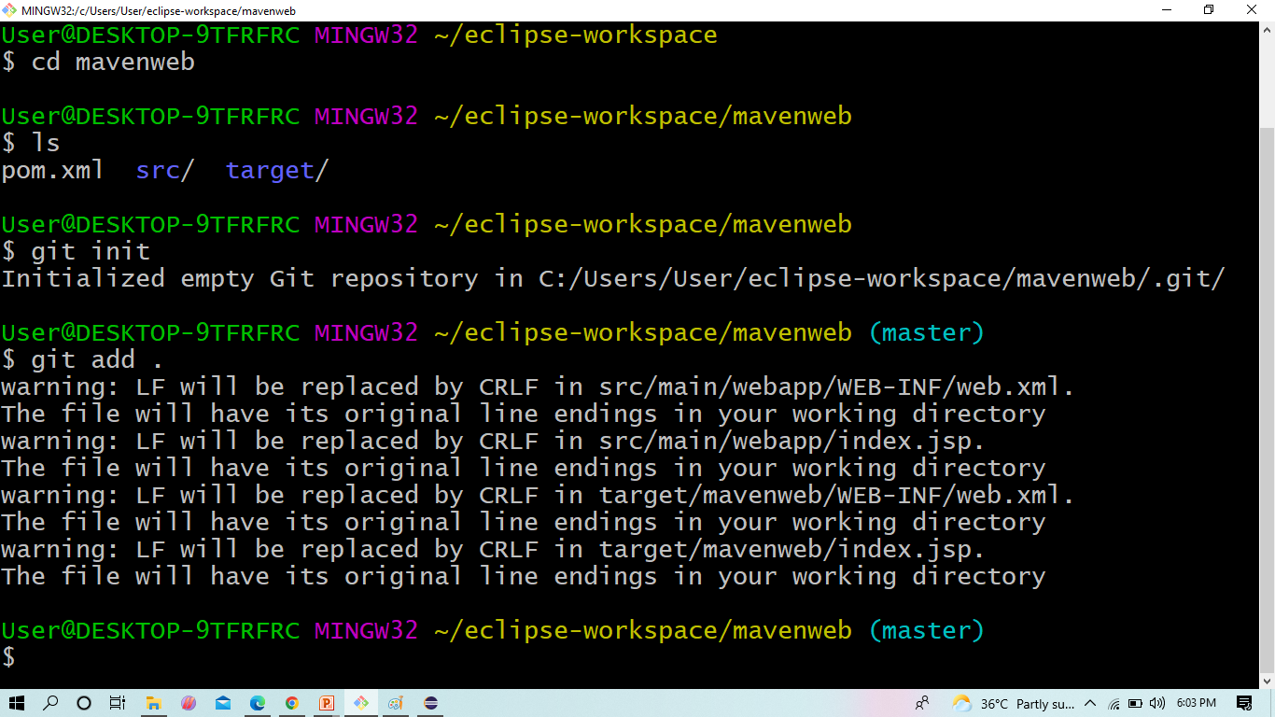
After getting in the path ,go for ls, git init and git add .
Maven Web Project in Eclipse

Slide 26
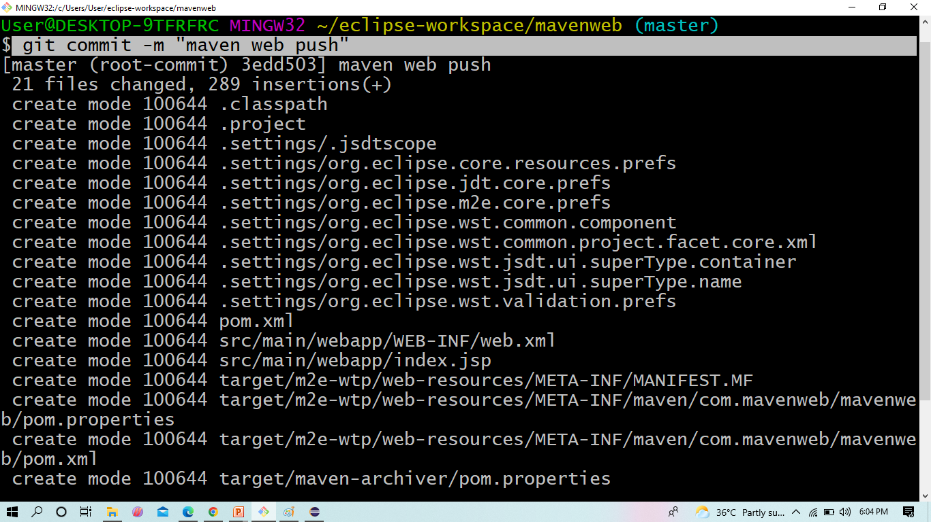
and go for git commit
Maven Web Project in Eclipse

Slide 27
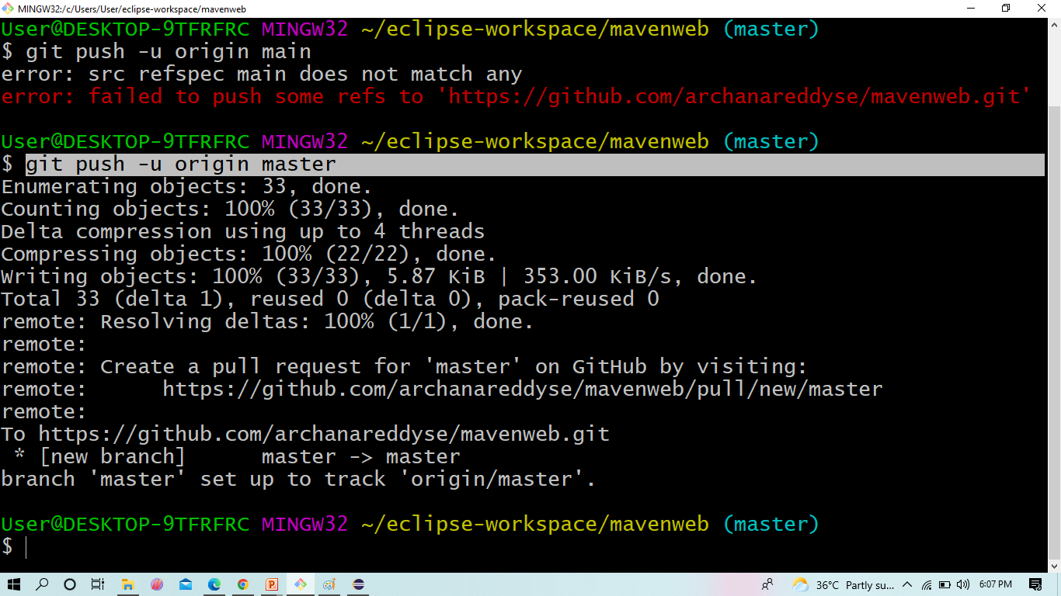
Now push into the git hub .
Maven Web Project in Eclipse

Slide 28
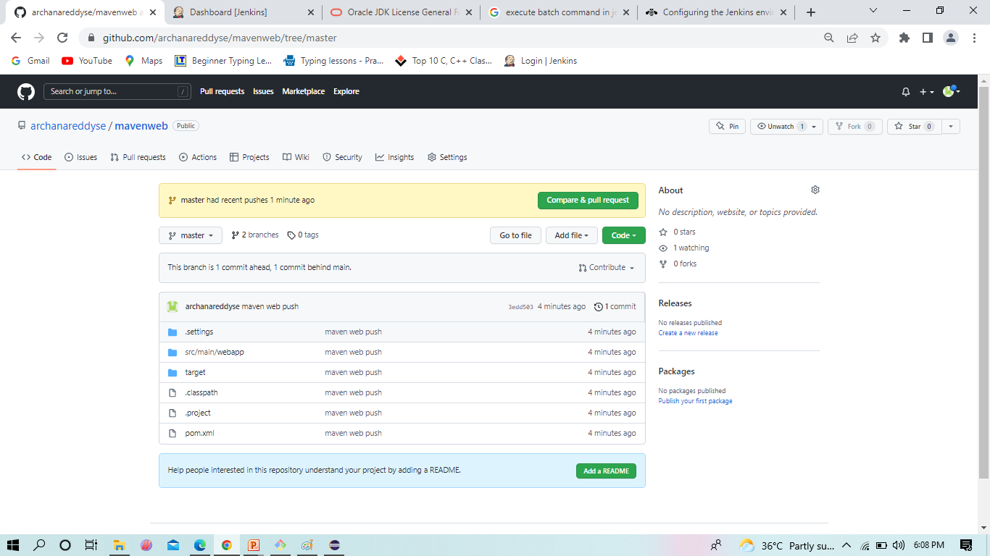
After pushing from git bash ,now refresh the git hub we see all the files are reflected here.
Maven Web Project in Eclipse

Slide 29
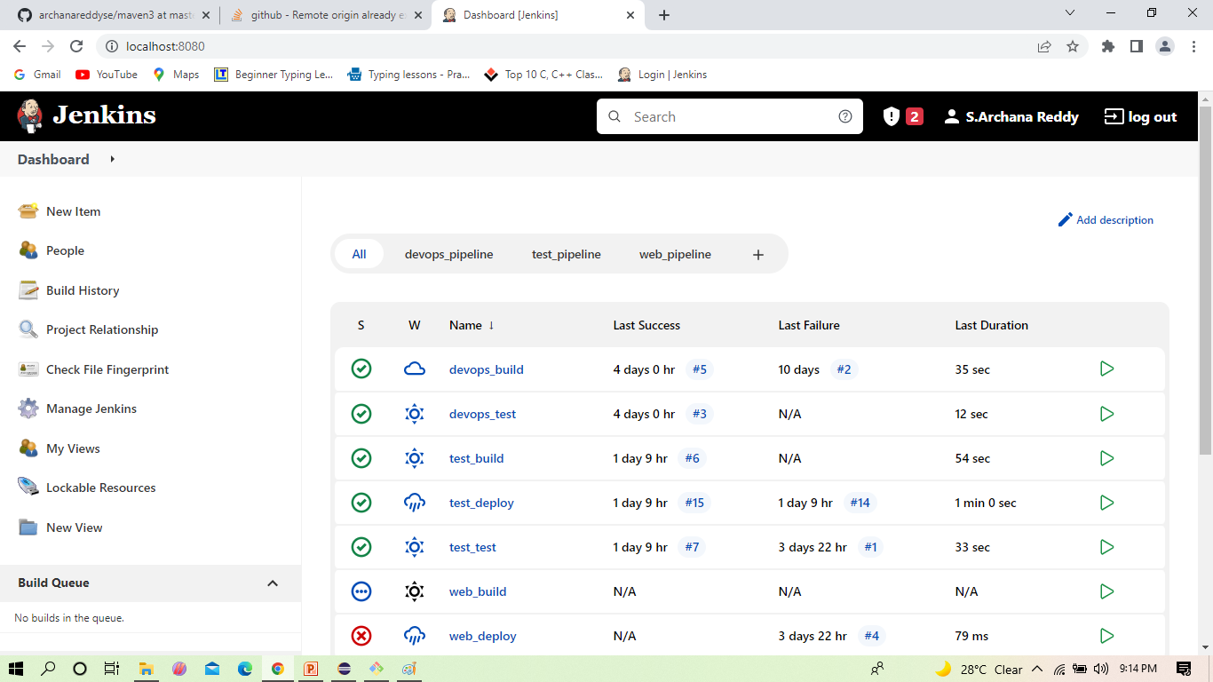
Now come to jenkins ,here we will create the new item
Maven Web Project in Eclipse

Slide 30
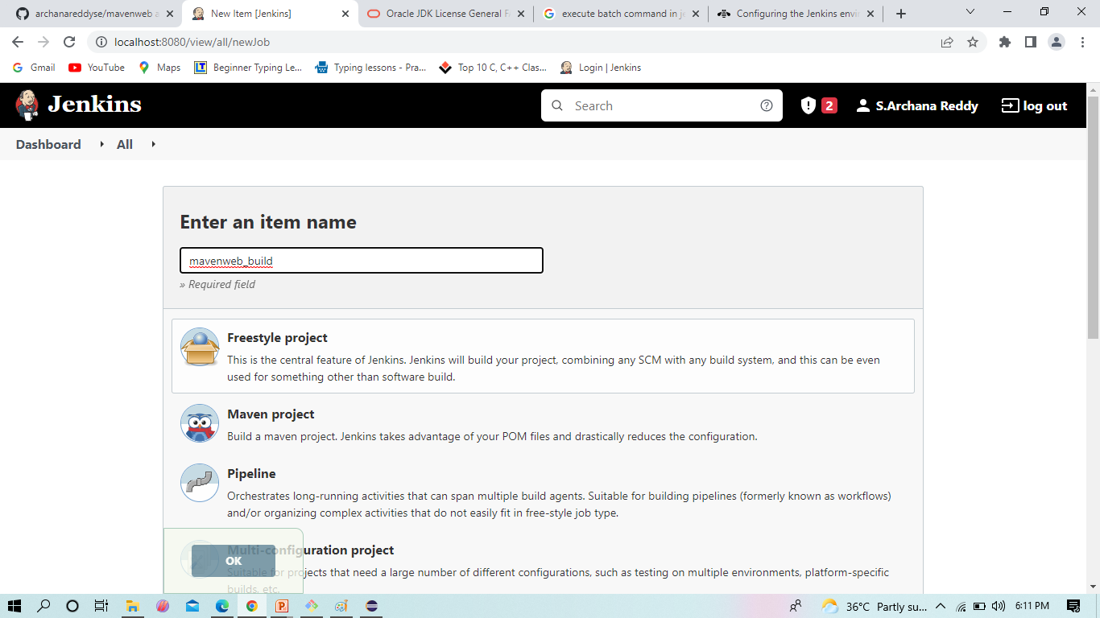
Name it, and select as -> freestyle project ,click on-> ok.
Maven Web Project in Eclipse

Slide 31
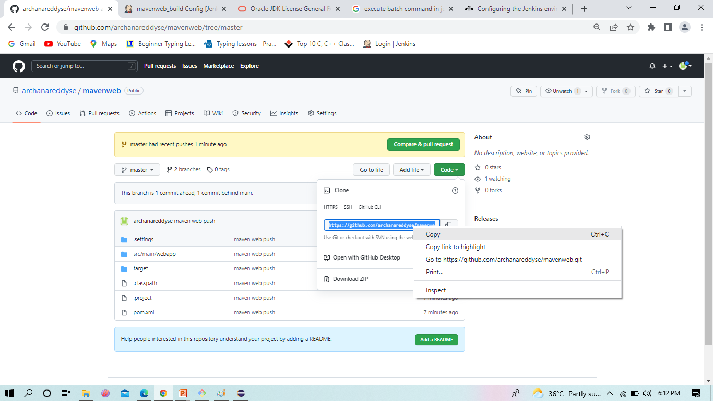
Copy the git hub http code
Maven Web Project in Eclipse

Slide 32
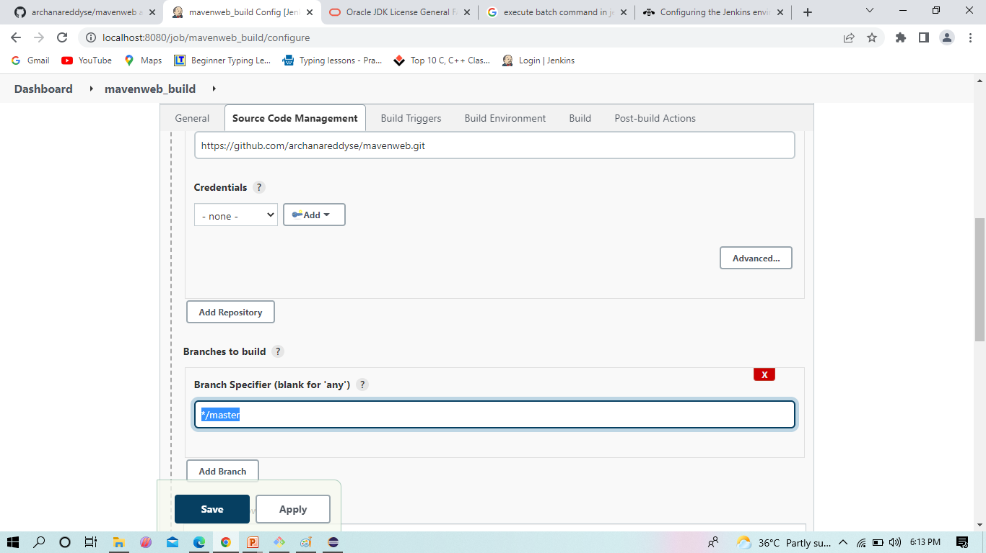
Paste the code in GIT URL ,check for master /main.
Maven Web Project in Eclipse

Slide 33
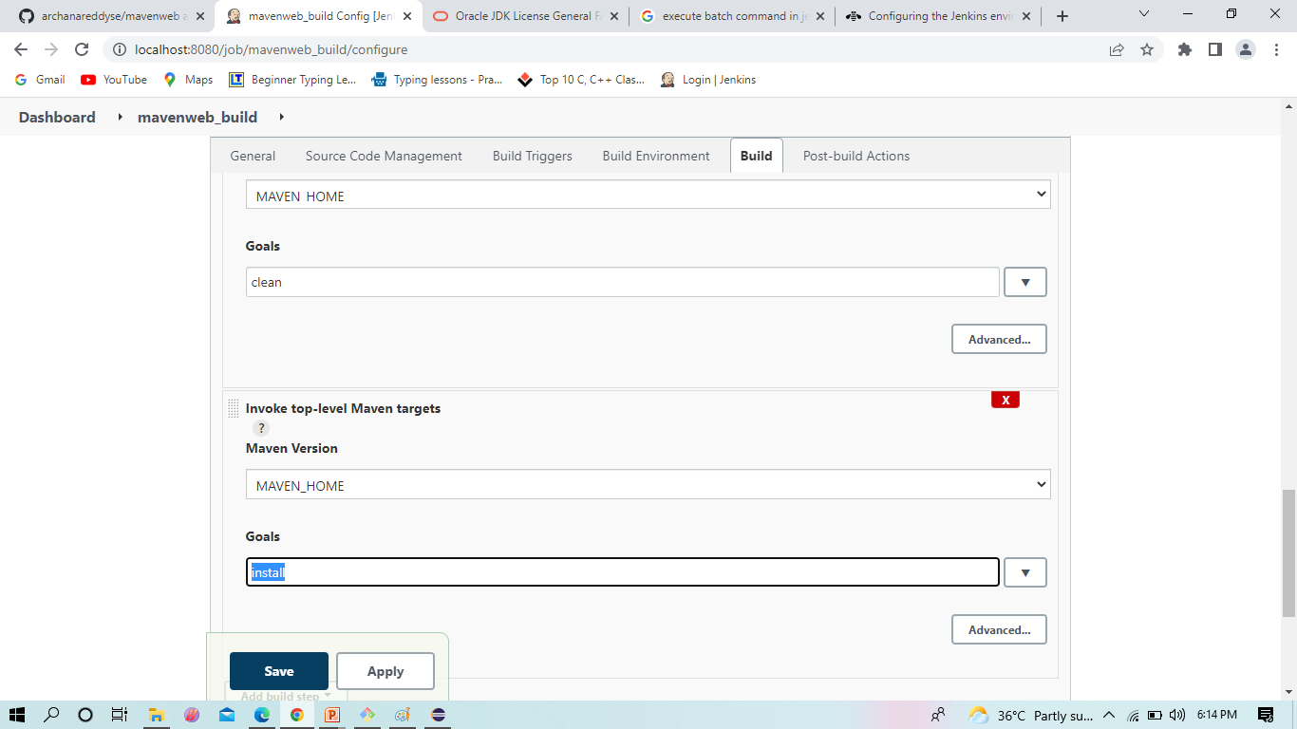
Here we going for main.
Maven Web Project in Eclipse

Slide 34
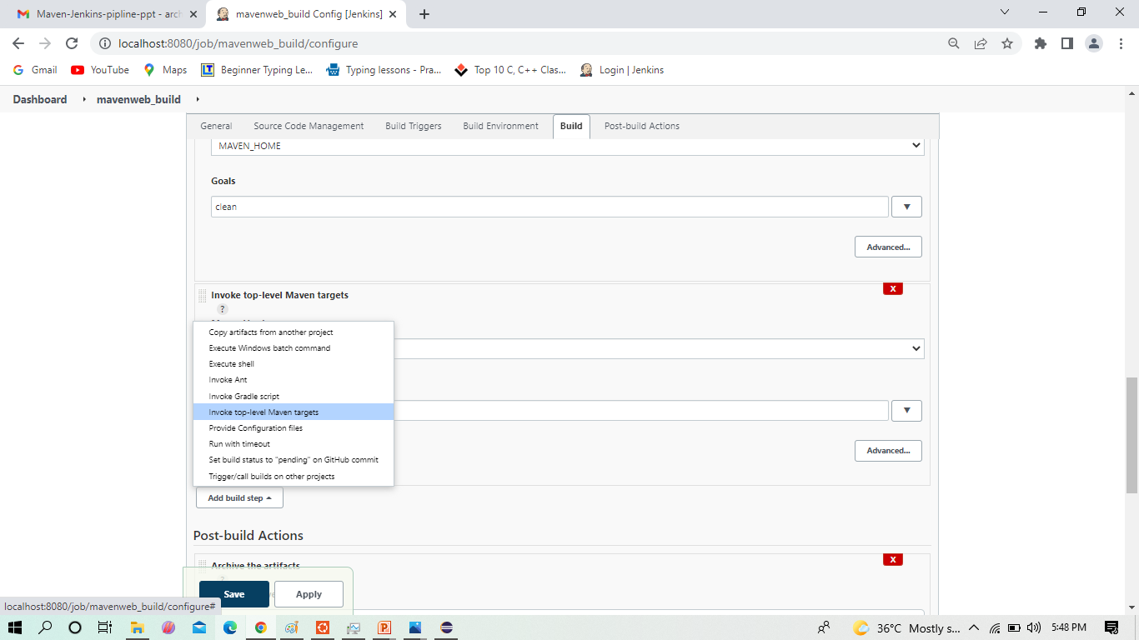
Now in Build, Invoke top-level Maven targets
Maven Web Project in Eclipse

Slide 35
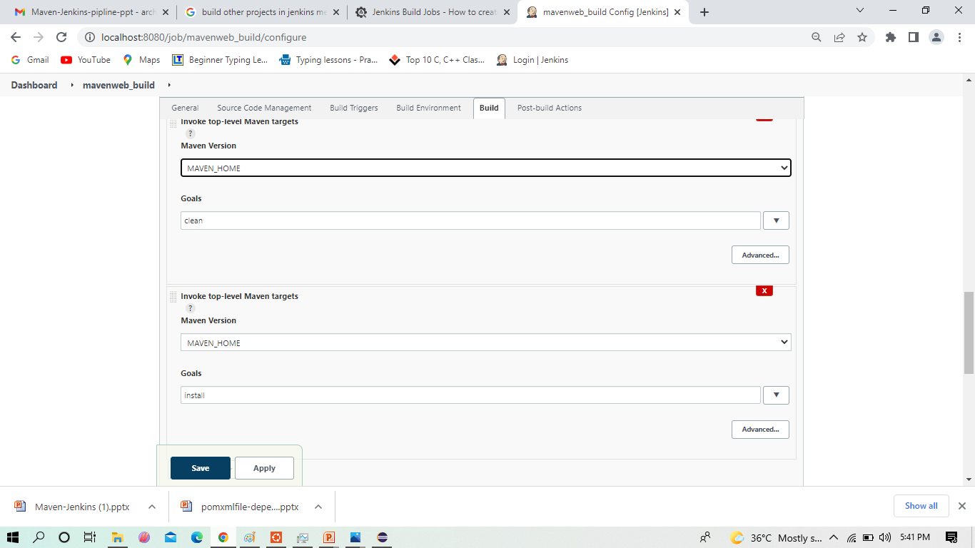
Select the Maven path which is already set in the global credentials in Manage Jenkins
Maven Web Project in Eclipse

Slide 36
Select the Maven path which is already set in the global credentials in Manage Jenkins
Maven Web Project in Eclipse

Slide 37
Now we follow the goals of as starting with clean and install
Maven Web Project in Eclipse

Slide 38
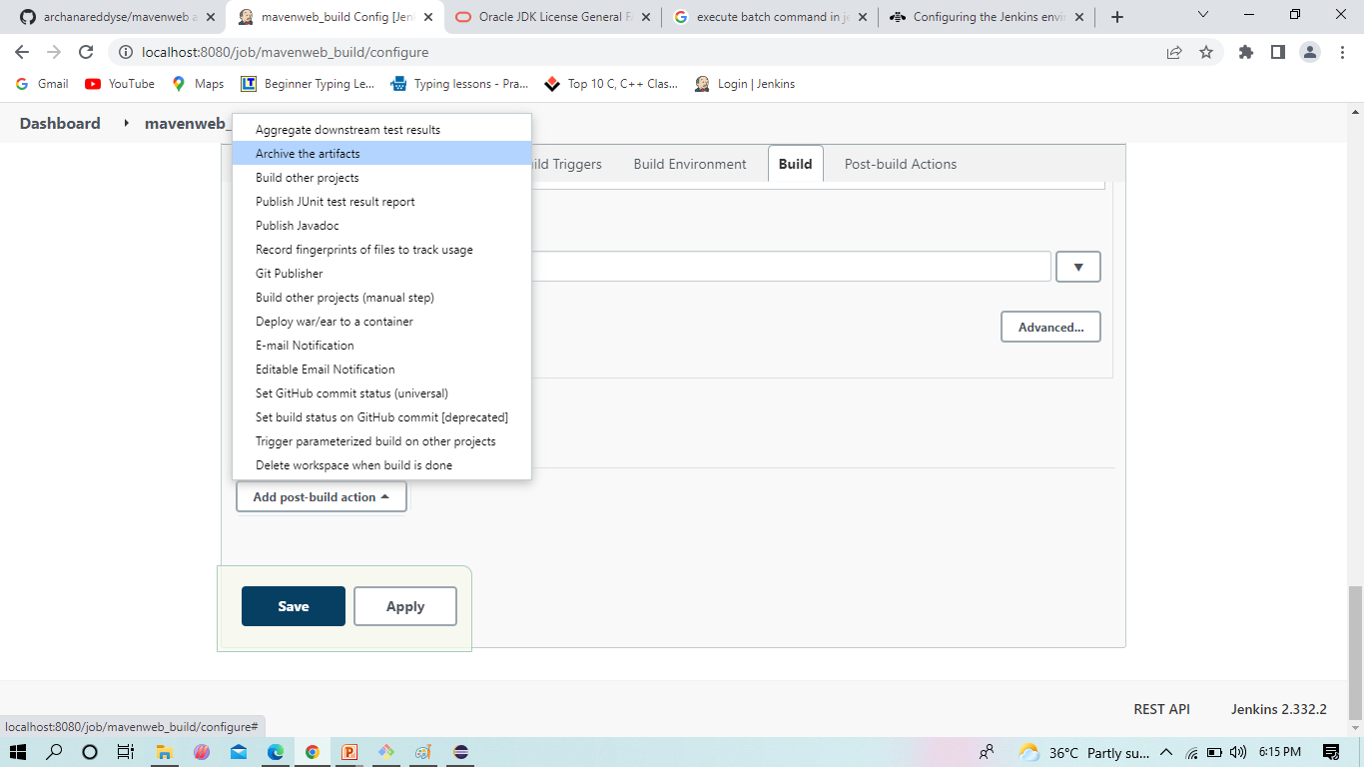
Now we go for post build select the Archive artifacts -in Jenkins is a feature that allows us to store the output files after we build the project with Jenkins.
Maven Web Project in Eclipse

Slide 39
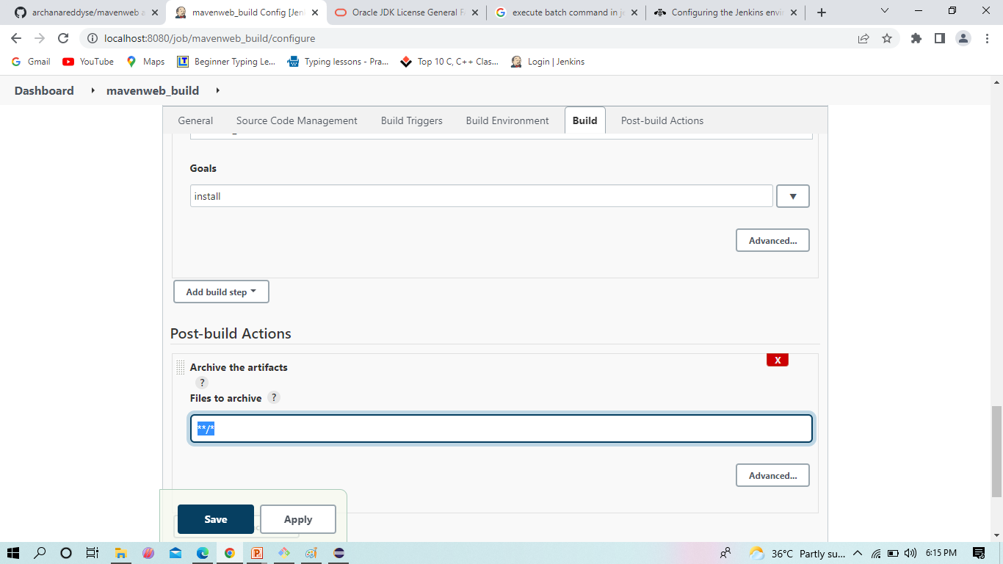
To archive the artifacts we go for **/*.
Maven Web Project in Eclipse

Slide 40
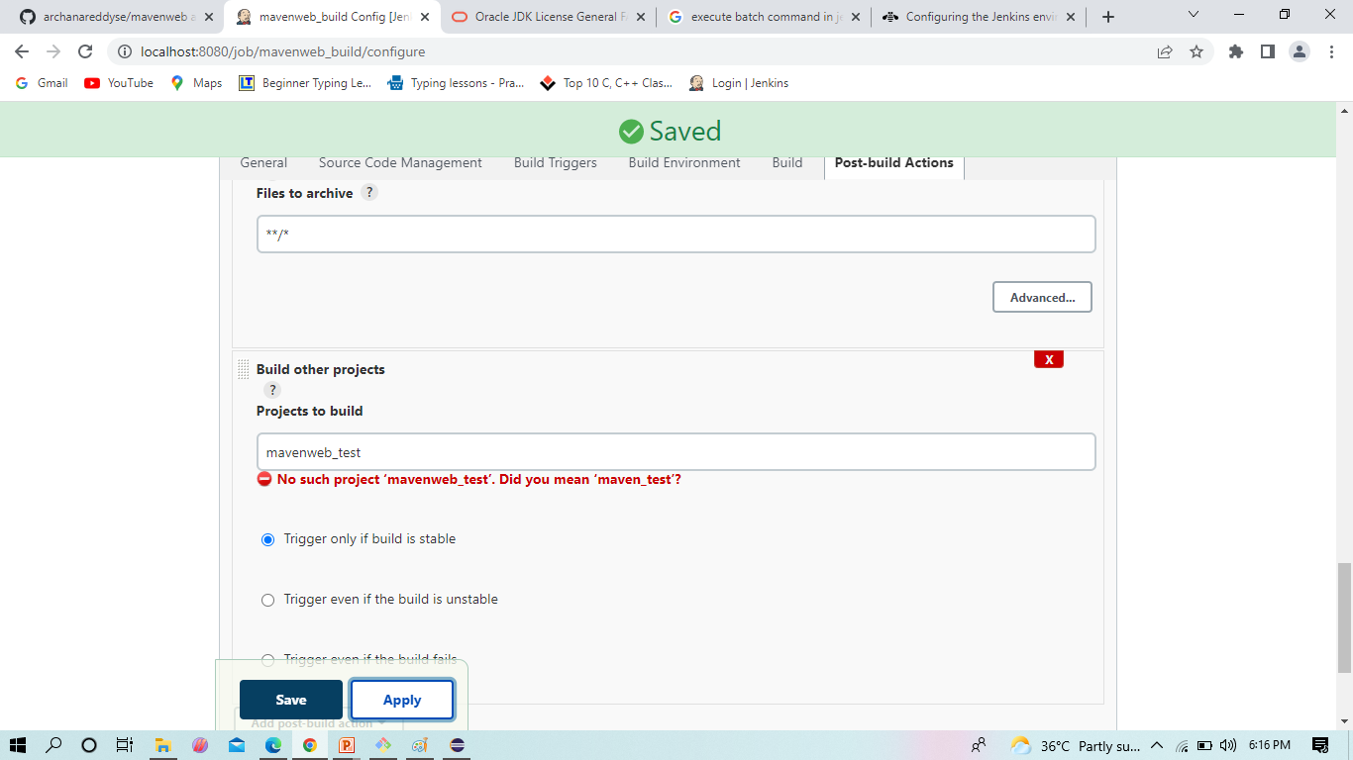
Now we here select the build other projects, where we will create a test project which will be triggered by the build project, click on Apply and Save
Maven web Project in Eclipse

Slide 41

Maven Web Project in Eclipse
Create a new freestyle project test as shown and click ok

Slide 42
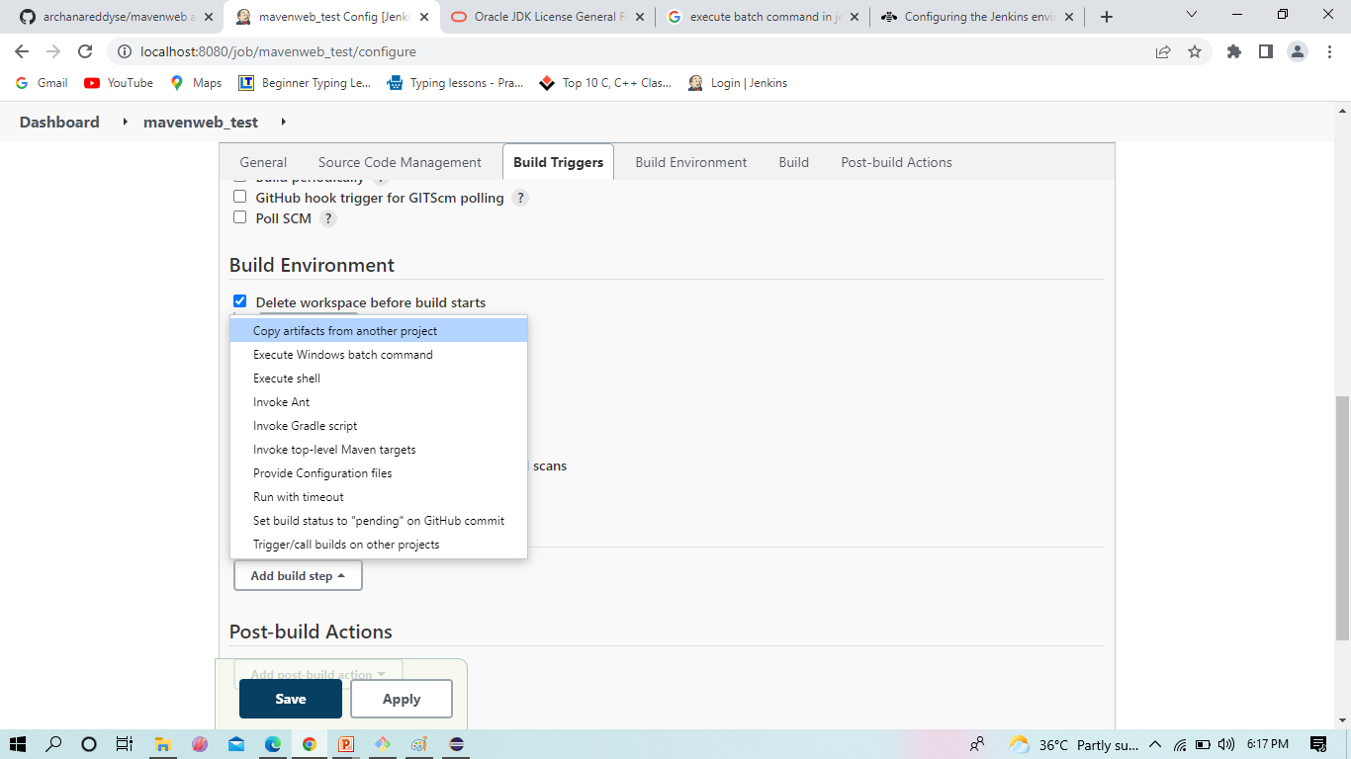
In Build environment check the box as shown below, this is to discard old builds To forward the artifacts of the previous project to the current test project, select copy the artifacts from another project in Build as shown
Maven Web Project in Eclipse

Slide 43
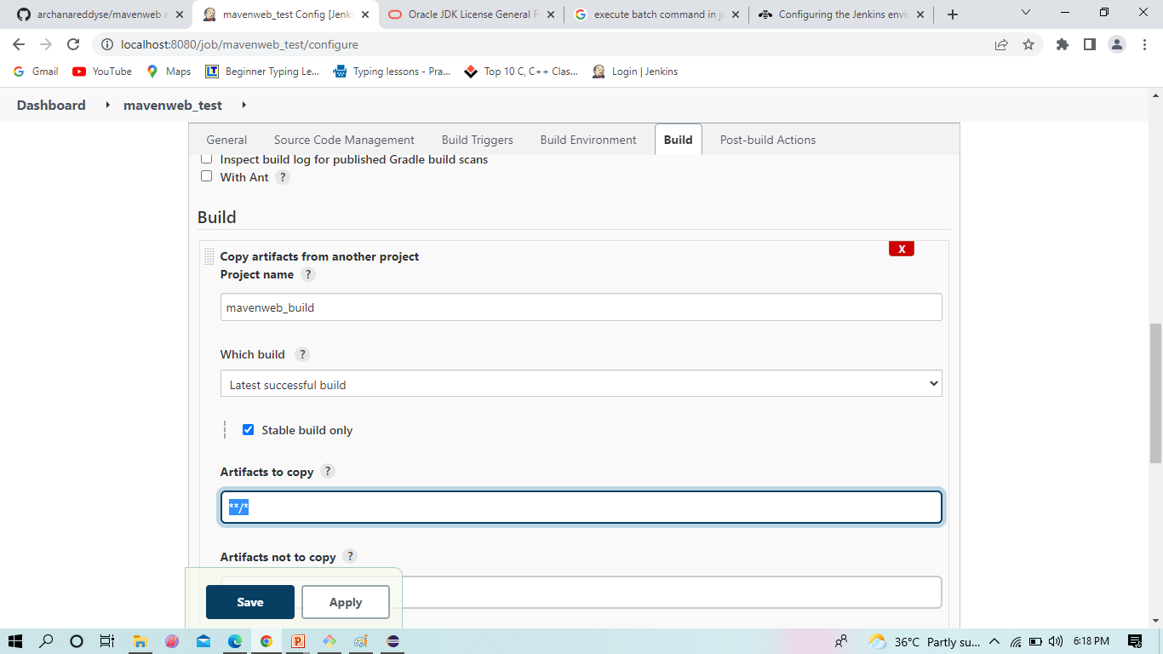
Give the name of the project from which we want to copy the artifacts and check the box ->stable build only->to copy all the artifacts type **/*
Maven Web Project in Eclipse

Slide 44
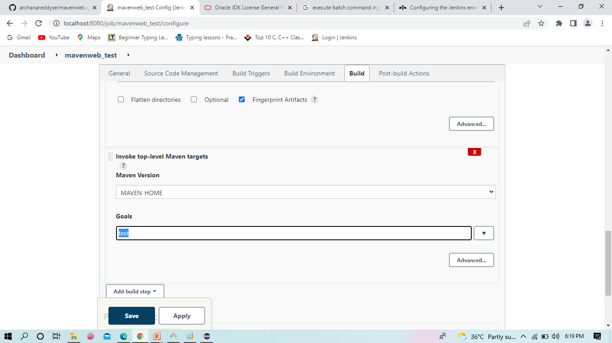
Maven Web Project in Eclipse
Now in Build, Invoke top-level Maven targets, choose the Maven Path and select goal as test

Slide 45
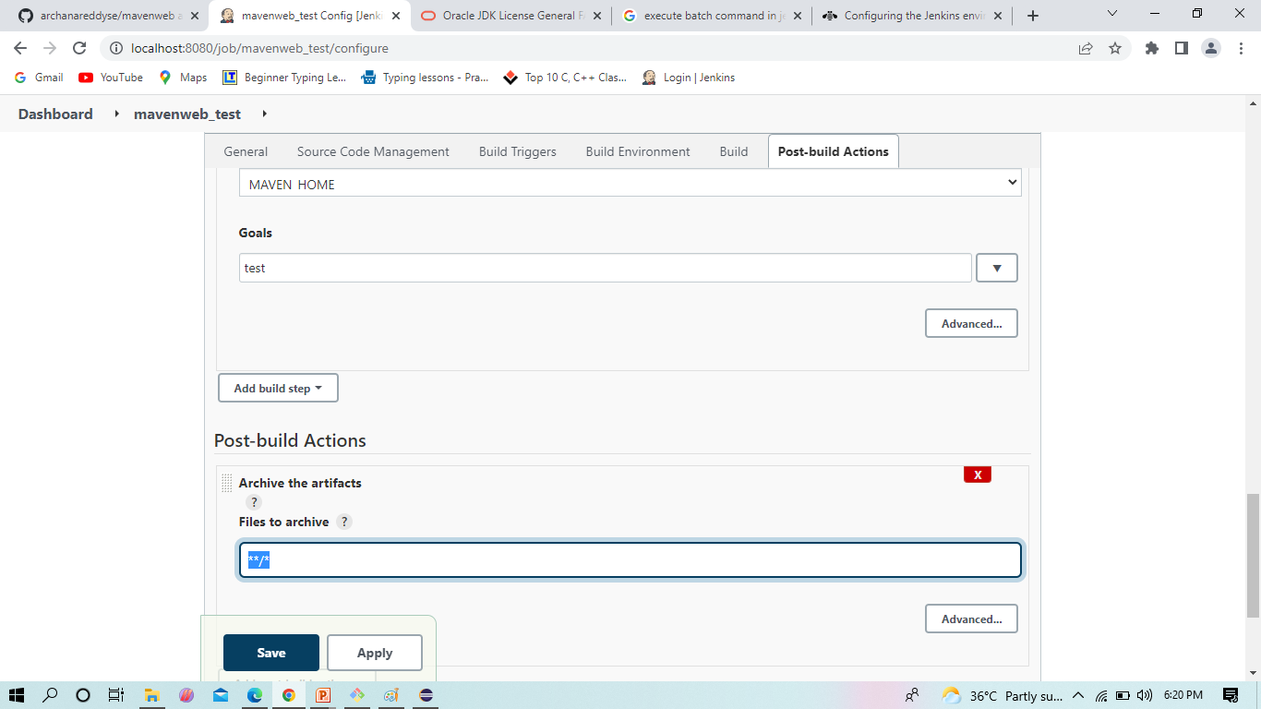
To archive the artifacts we go for **/*.
Maven Web Project in Eclipse

Slide 46
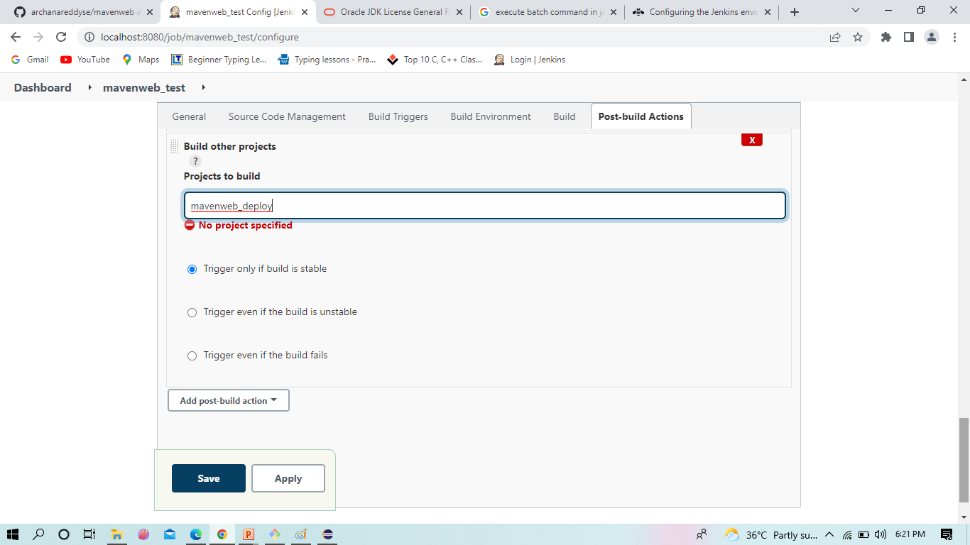
Now we here select the build other projects, where we will create a deploy project which will be triggered by the test project, click Apply and Save
Maven Web Project in Eclipse

Slide 47

Create a new freestyle project test as shown and click ok
Maven Web Project in Eclipse

Slide 48
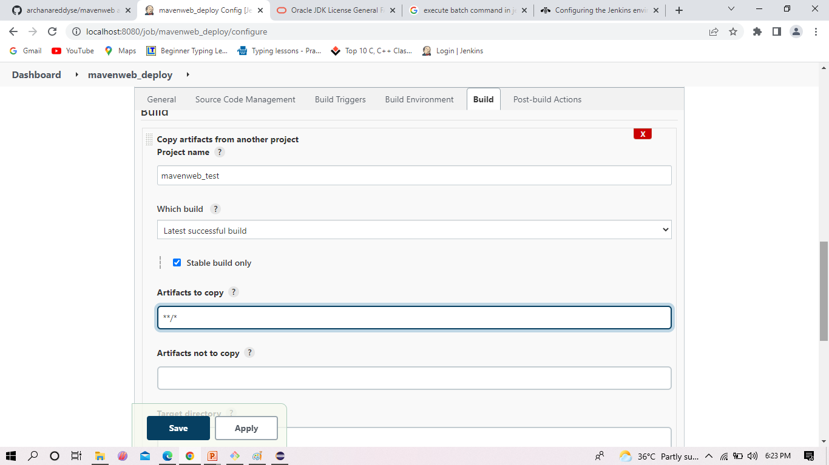
Give the name of the project from which we want to copy the artifacts and check the box ->stable build only->to copy all the artifacts type **/*
Maven Web Project in Eclipse

Slide 49
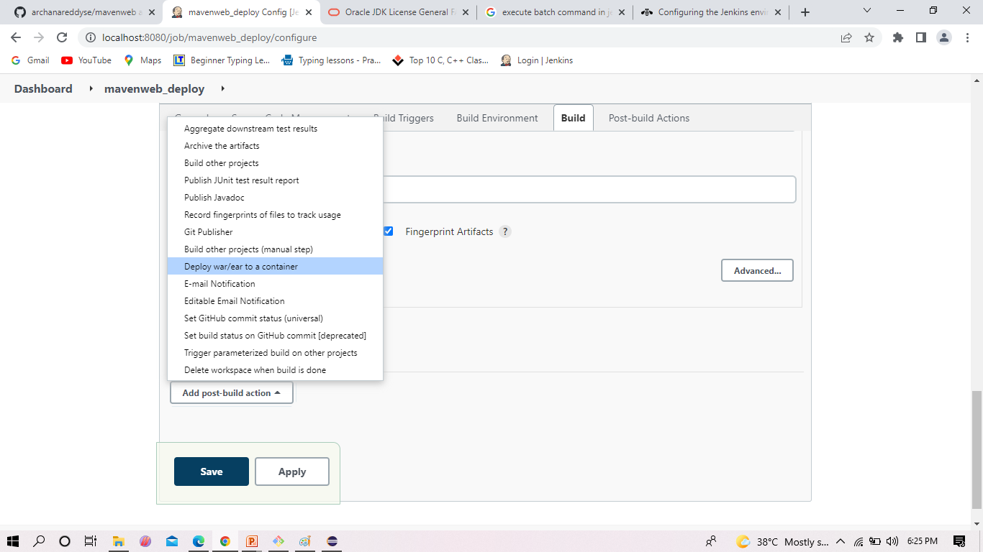
Now here we go for Add post –build action where we select the Deploy war/ear to a container. This plugin takes a war/ear file and deploys that to a running remote application server at the end of a build.
Maven Web Project in Eclipse

Slide 50
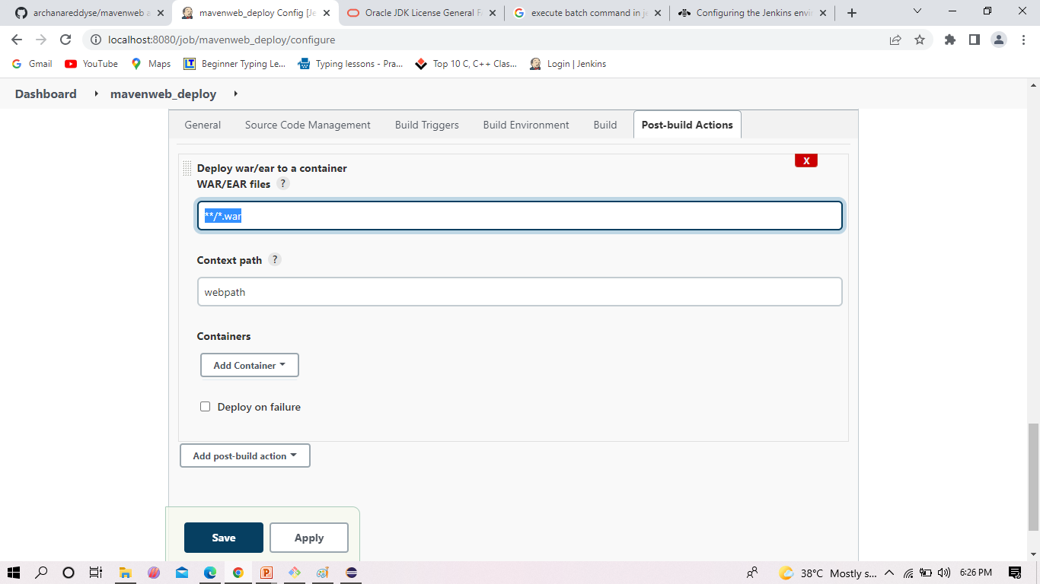
Deploy war/ear to a container takes the artifacts as **/*.war and Context Pathas webpath or any name where you will bw able to see the web output
Maven Web Project in Eclipse

Slide 51
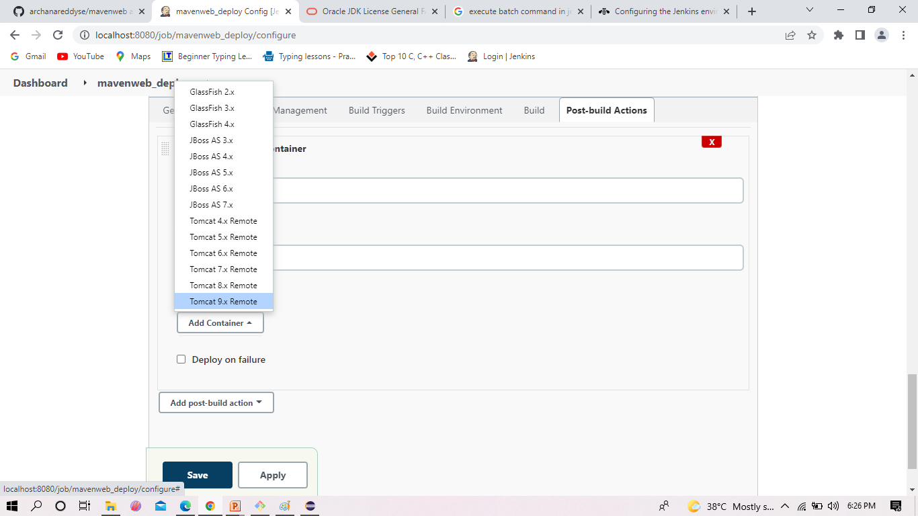
Here we select the tomcat version at Add Container .
Maven Web Project in Eclipse

Slide 52
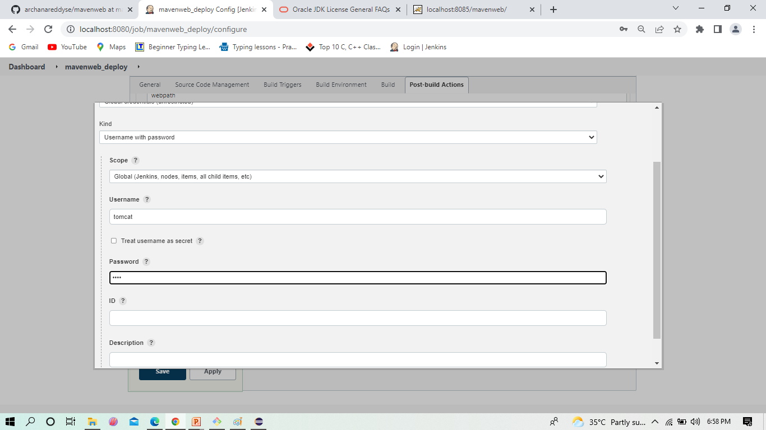
Here we add the credentials of tomcat what you gave while installing tomcat i.e., user name admin password 1234 .
Maven Web Project in Eclipse

Slide 53
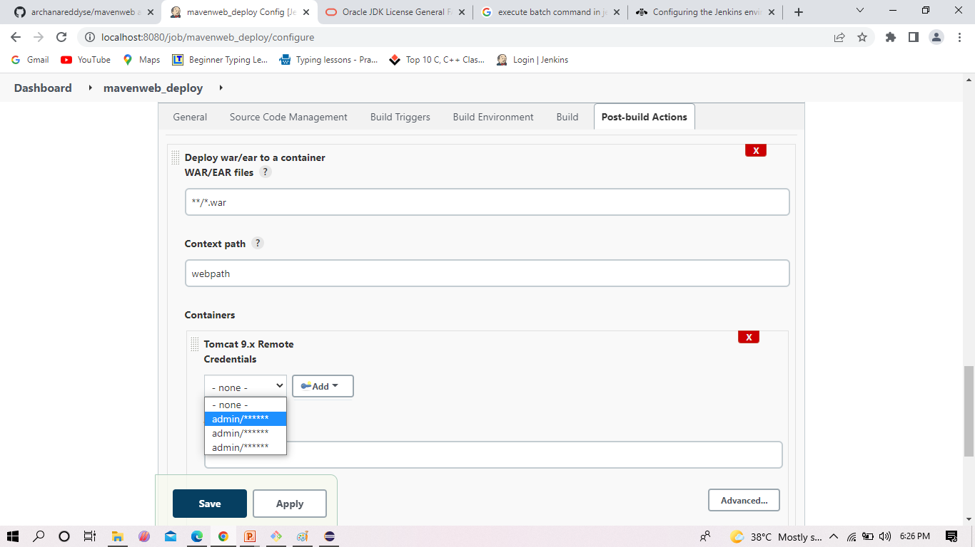
Here we added the credentials of tomcat and tomcat URL also.
Maven Web Project in Eclipse

Slide 54
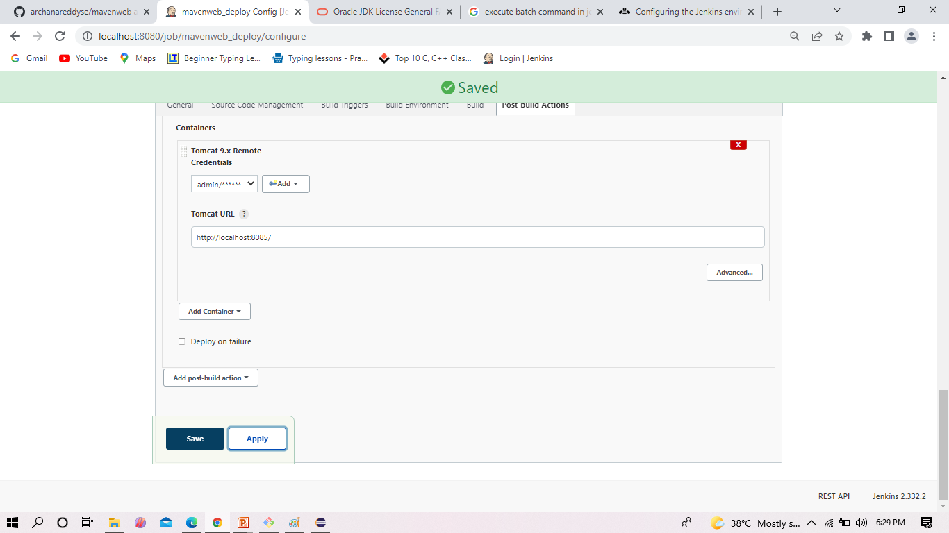
Now Apply and Save.
Maven Web Project in Eclipse

Slide 55
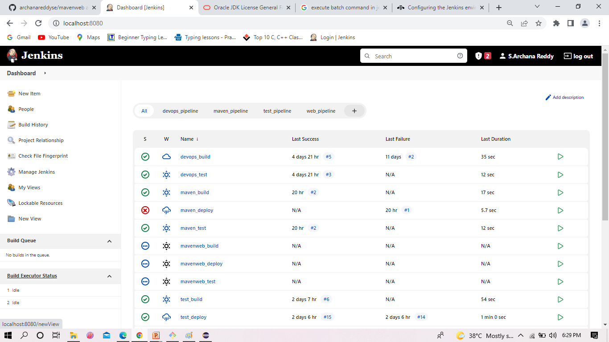
We Create a pipeline by clicking on + symbol in the dashboard ->a pipeline is a collection of events or jobs which are interlinked with one another in a sequence
Maven Web Project in Eclipse

Slide 56
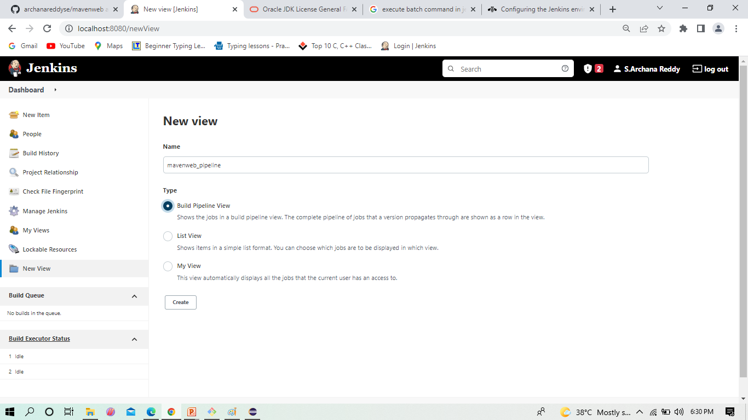
Give a name to the pipeline->select Build Pipeline View->create
Maven Web Project in Eclipse

Slide 57

Select the first project to trigger the execution->build session of your project
Maven Web Project in Eclipse

Slide 58

Apply and Save
Maven Web Project in Eclipse

Slide 59

This is the console after save .now click on run.
Maven Web Project in Eclipse

Slide 60

After Click on Run -> click on the small black box to open the console to check if the build is success
Maven Web Project in Eclipse

Slide 61

Now we see all the build has success.
Maven Web Project in Eclipse

Slide 62

Now we can run the local host of tomcat, click -> manager App
Maven Web Project in Eclipse

Slide 63

It ask for user credentials for login ,provide the credentials of tomcat.
Maven Project in Eclipse

Slide 64

It provide the page with out project name which is highlighted.
Maven Project in Eclipse

Slide 65

After clicking on our project we can see our output here .
Maven Web Project in Eclipse

